Slide 1
FRB Update #3
William Huang
(6/25/2020)

Slide 2
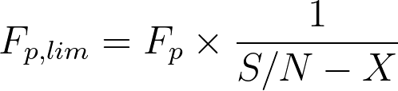

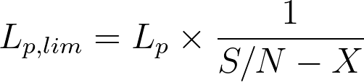
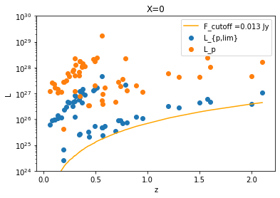
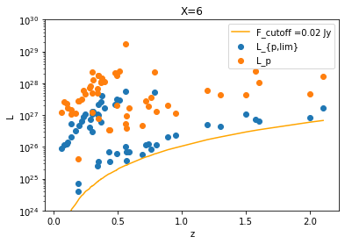
Using (S/N)-X
If Then I simply used F_{p,lim} = F_p.
The following were the graphs I plotted for L_{p,lim} and their flux cutoffs:

Slide 3
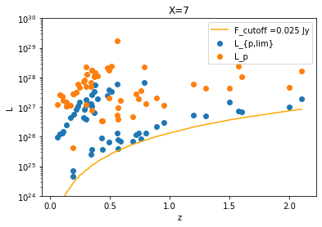
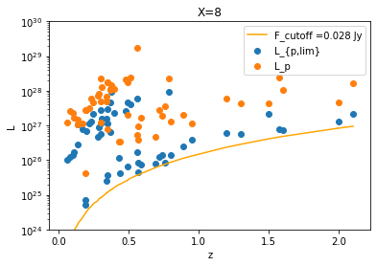
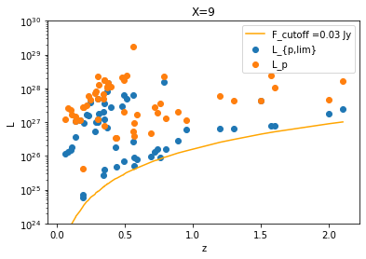
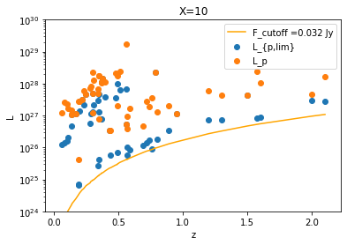

Slide 4
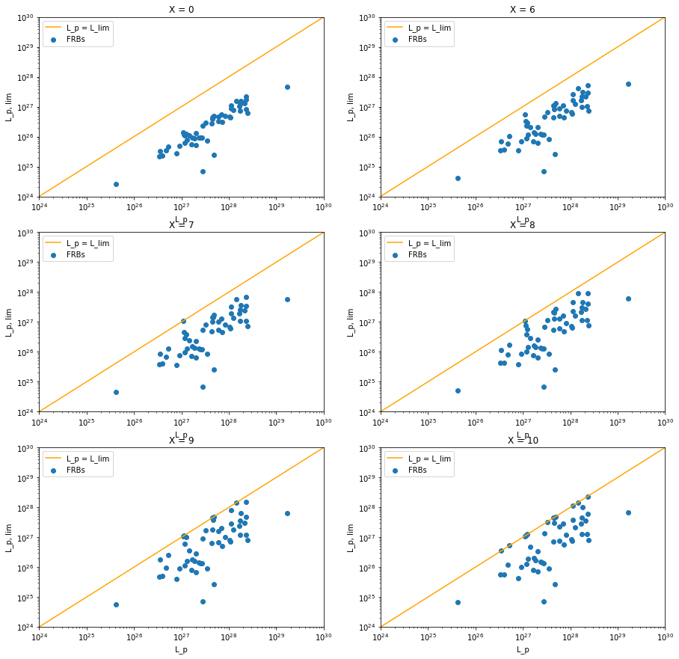
L_{p, lim} versus L_p using (S/N-X)

Slide 6
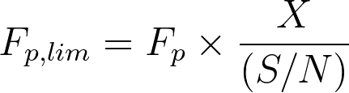
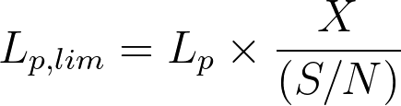
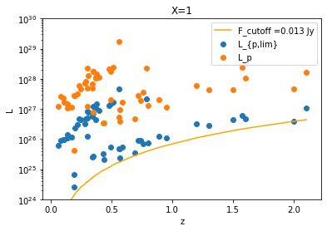
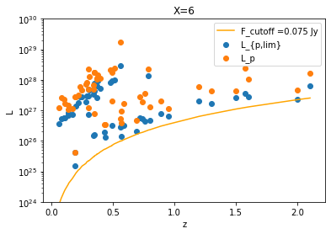
Using X/(S/N)
I plotted L_{p,lim} and their flux cutoffs:

Slide 7


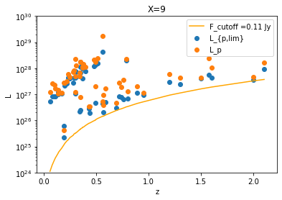
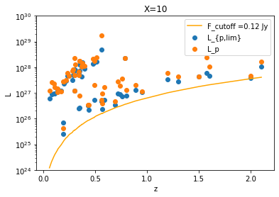

Slide 8
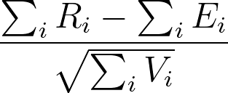
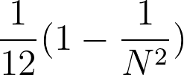
Kendall Tau
Working on implementing. Just to confirm, I am using the following definition:
Where
R_i is the relative rank of data point i within its luminosity associated set
E_i is the relative rank of data point i within its redshift associated set
V_i is the expected variance for my hypothesis, in this case because our hypothesis is there is no correlation. N is the number of data points within data point i’s luminosity associated set.

